Slide 1
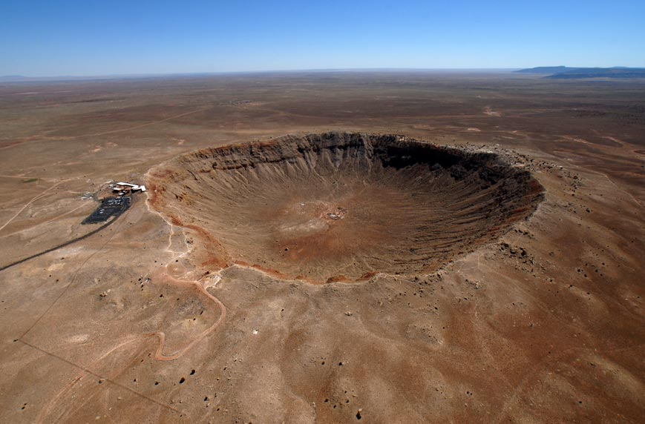
Impact Cratering

Slide 2
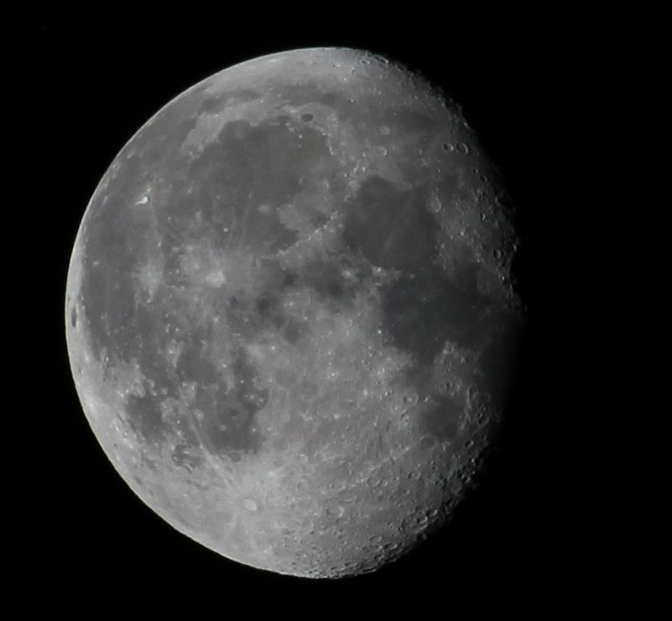
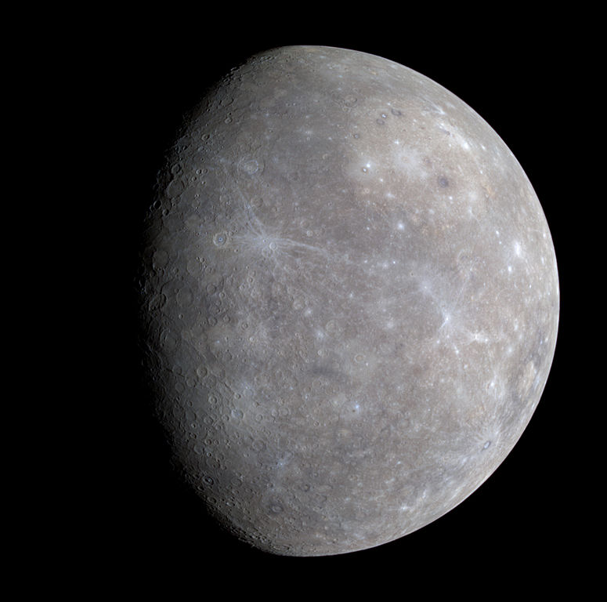
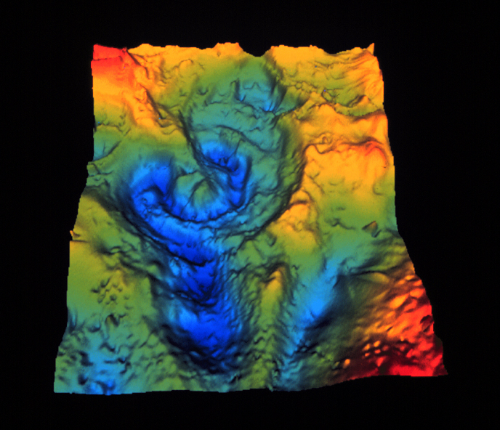
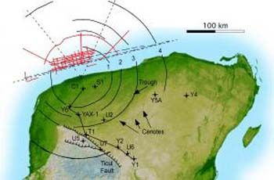
Impact Craters
Formed by debris from a comet, asteroid, or meteroids impact the surface of a terrestrial planet
Moon and Mercury both show the evidence of this bombardment
Other bodies like Earth have weathering processes which hide these impacts
Force of impact generally destroys the impactor, and forms a crater 10-20x larger than the size of the impactor
Craters are generally circular, but they may be oval if the impact was at an oblique angle
Notes:
Chicxulub 6mi wide impactor that generated a 110mi crater, one of the largest confirmed impact craters.

Slide 3
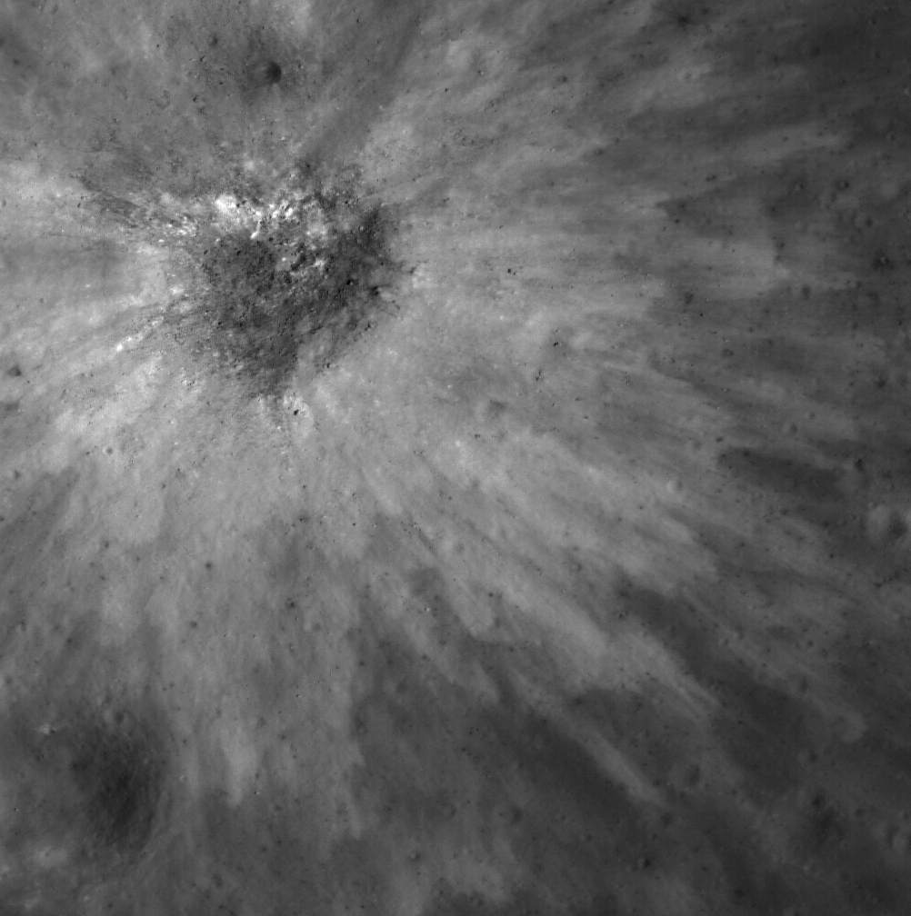
Lunar Ejecta

Slide 4
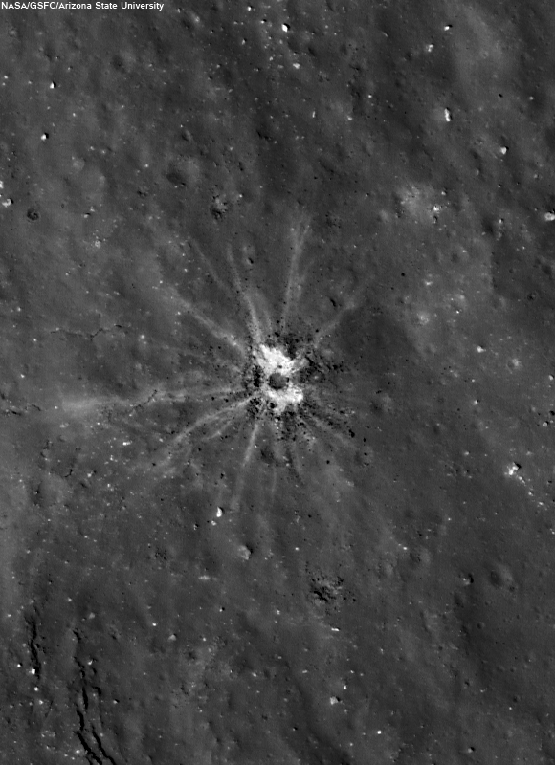
Lunar Rays

Slide 5
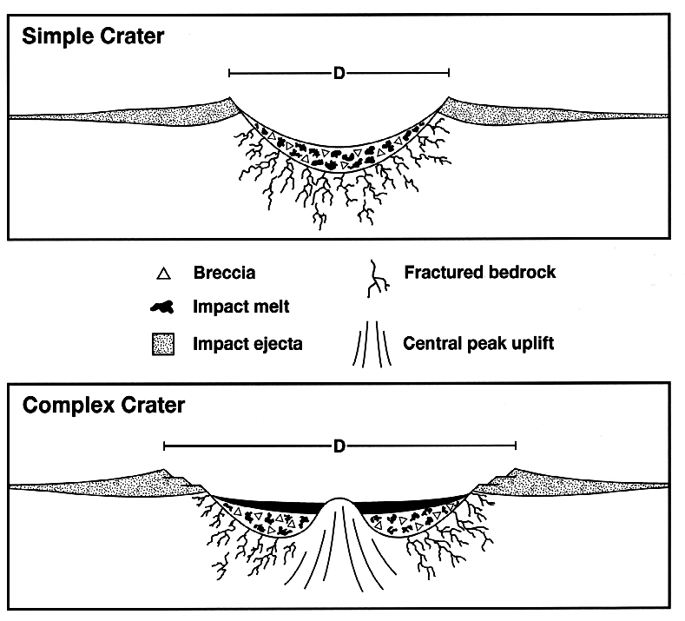
Anatomy of an Impact Crater
Notes:
Simple Crater:
Generally less than 1km, formed by projectiles of low speed and energy. Debris falls back into crater which is Breccia fill.
Complex Crater:
Much more shallow, 1:10 to 1:20 depth:width ratio. Flat floors, central uplift, slump blocks and terraces.

Slide 6
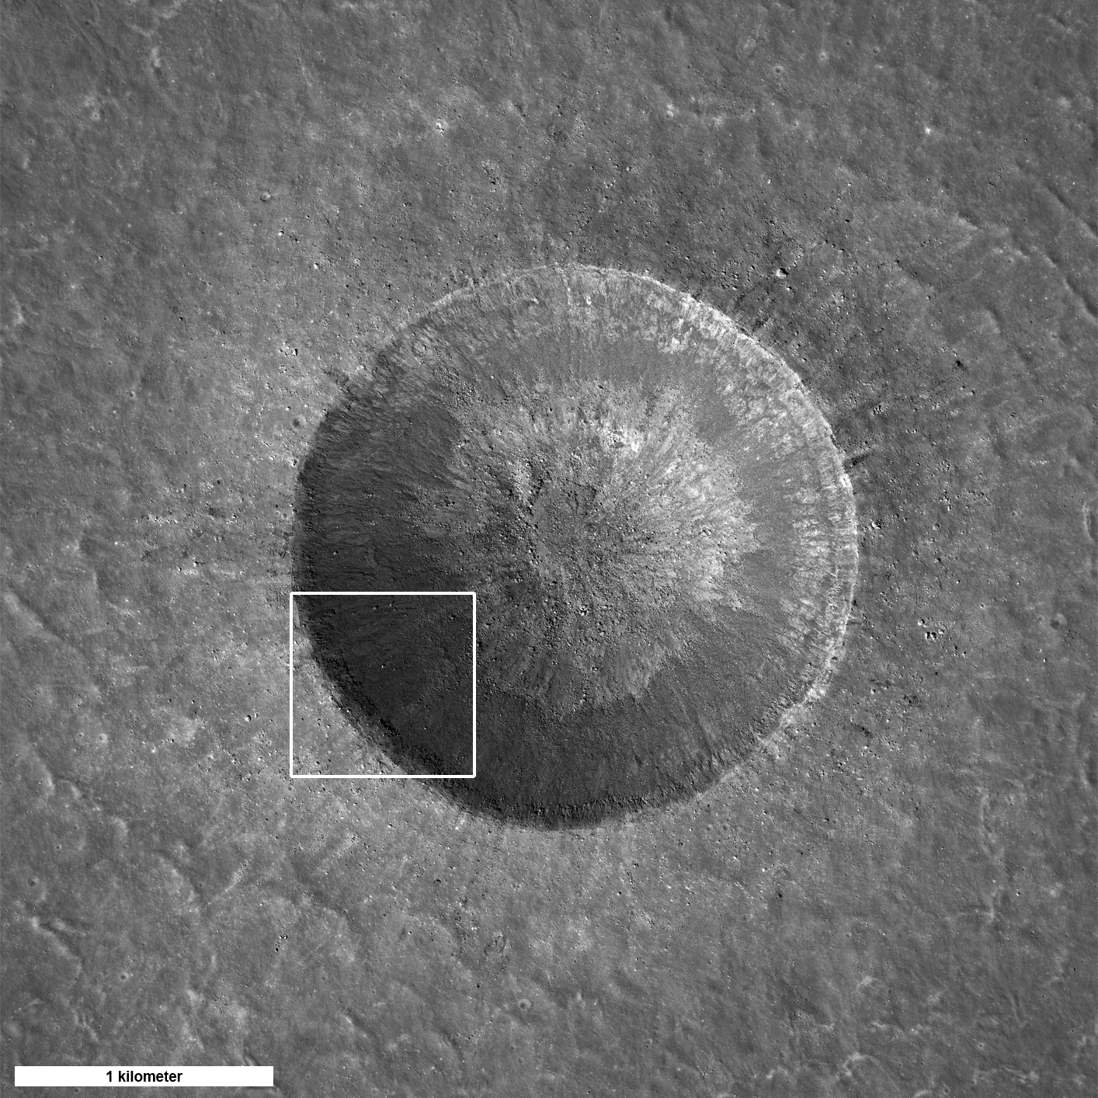
Simple Crater
Notes:
Linne Crater, Moon

Slide 7
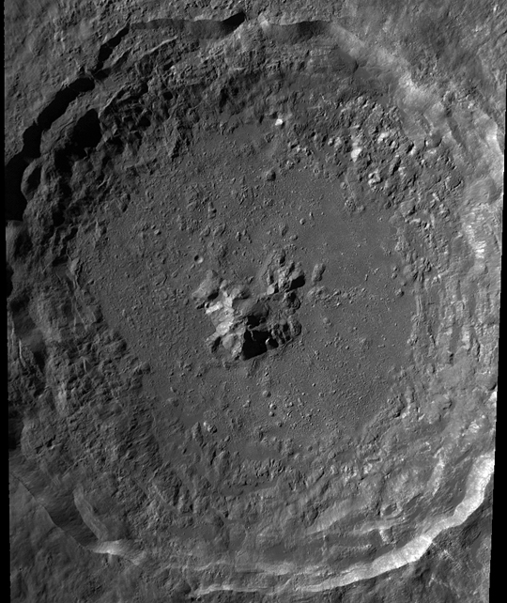
Complex Craters: Central Peak
Notes:
Tycho Crater, Moon
1-10km, have a rebound of material in the center

Slide 8
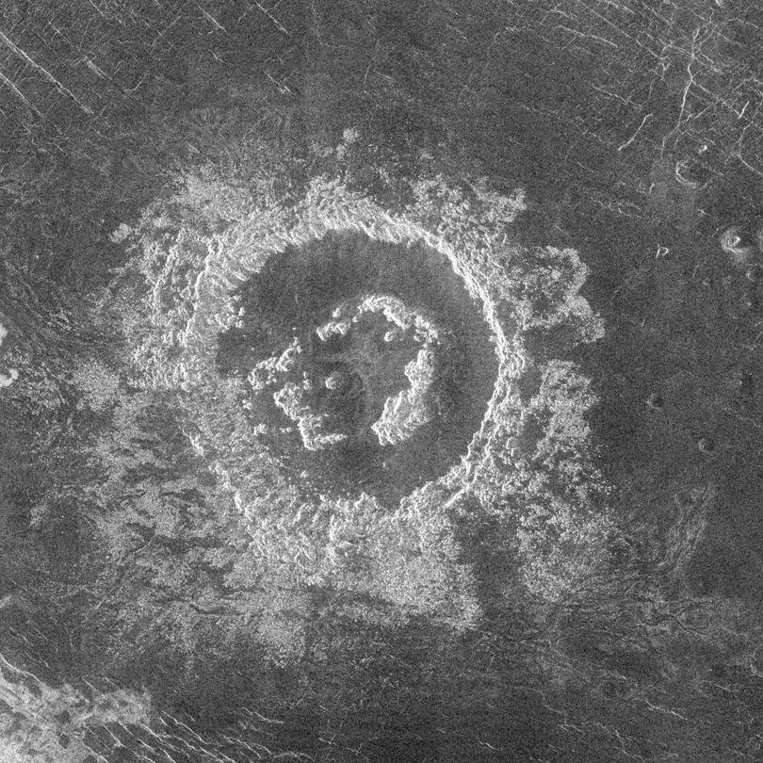
Complex Craters: Peak Ring
Notes:
Barton Crater, Venus
100-300km form ring of mountains in the center

Slide 9
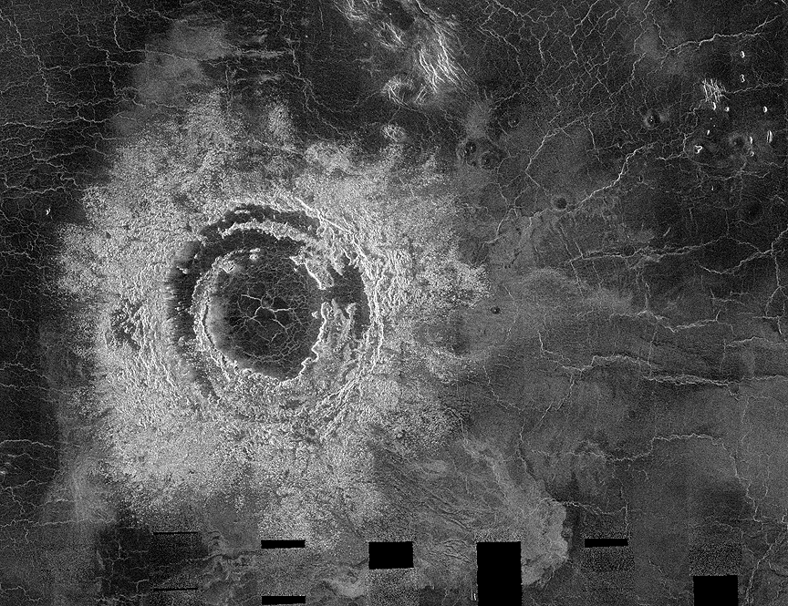
Complex Craters: Multi-Ring
Notes:
Mona Lisa Crater on Venus
~1000km in diameter… high velocity impact

Slide 10
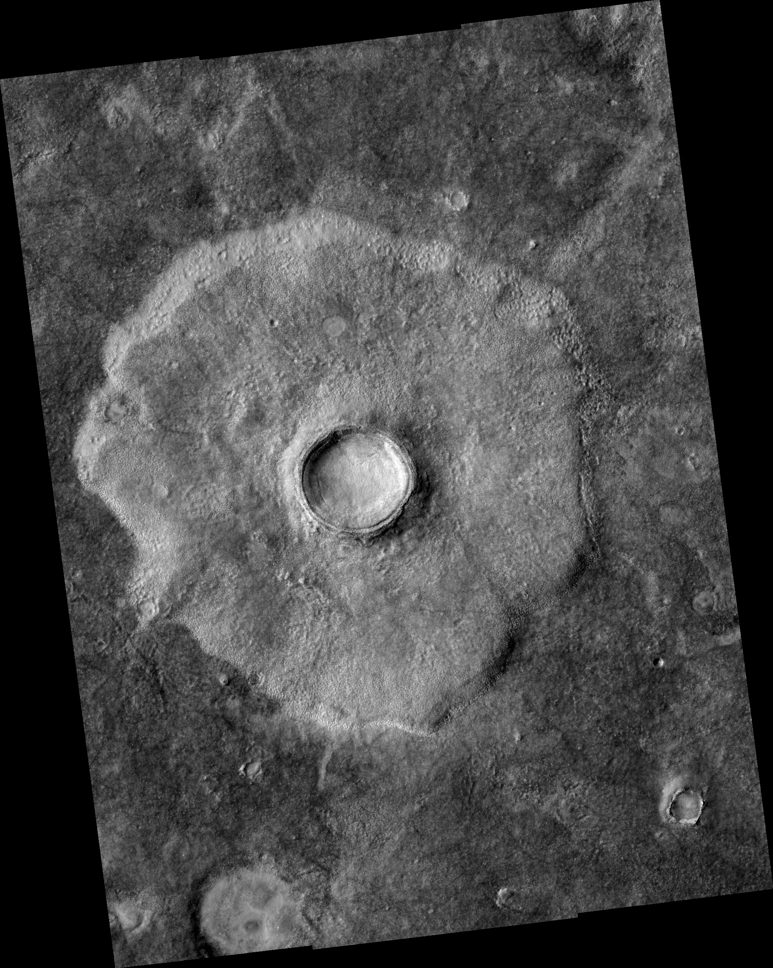
Rampart Crater
Notes:
Rampart Crater, Mars
Lobes around crater similar to volcanic/mud flows.

